Slide 1
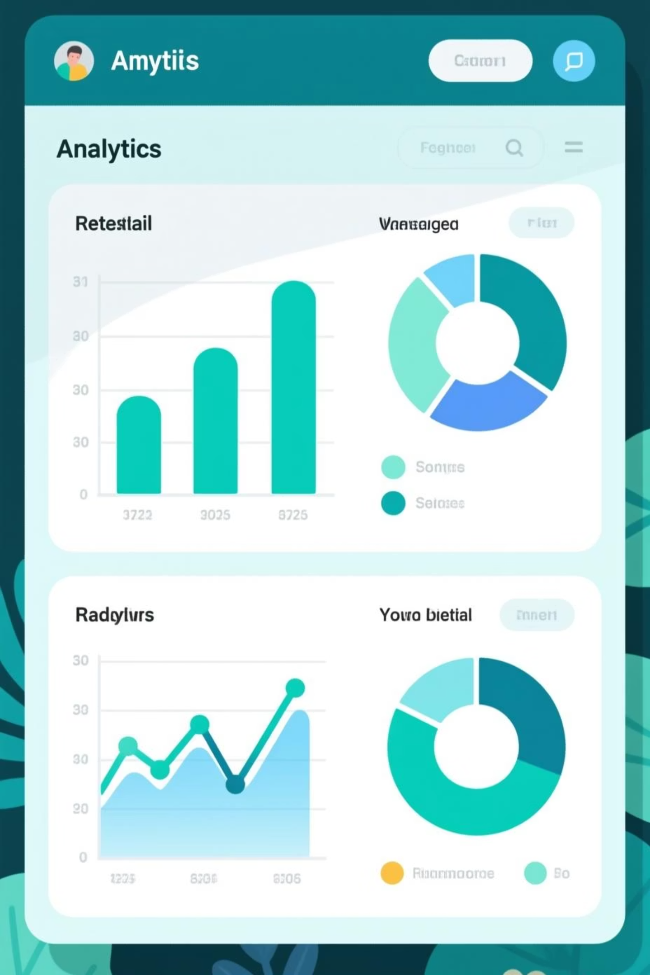
Customer Shopping Behavior Analysis
Uncovering insights from 3,900 purchases to drive strategic business decisions

Slide 2

Project Scope
Dataset Overview
Analysis Goals
3,900 purchases analyzed across multiple product categories
Uncover spending patterns
Identify customer segments
Analyze product preferences
18 key features tracking demographics, purchases, and behavior
Evaluate subscription behavior
50 locations spanning diverse customer base

Slide 3

Data Preparation Journey
01
Data Loading & Exploration
Imported dataset using pandas, analyzed structure with df.info() and summary statistics
02
Missing Data Handling
Imputed 37 missing Review Rating values using median rating per product category
03
Feature Engineering
Created age_group bins and purchase_frequency_days for deeper analysis
04
Database Integration
Connected Python to MySQL, loaded cleaned data for SQL analysis

Slide 4
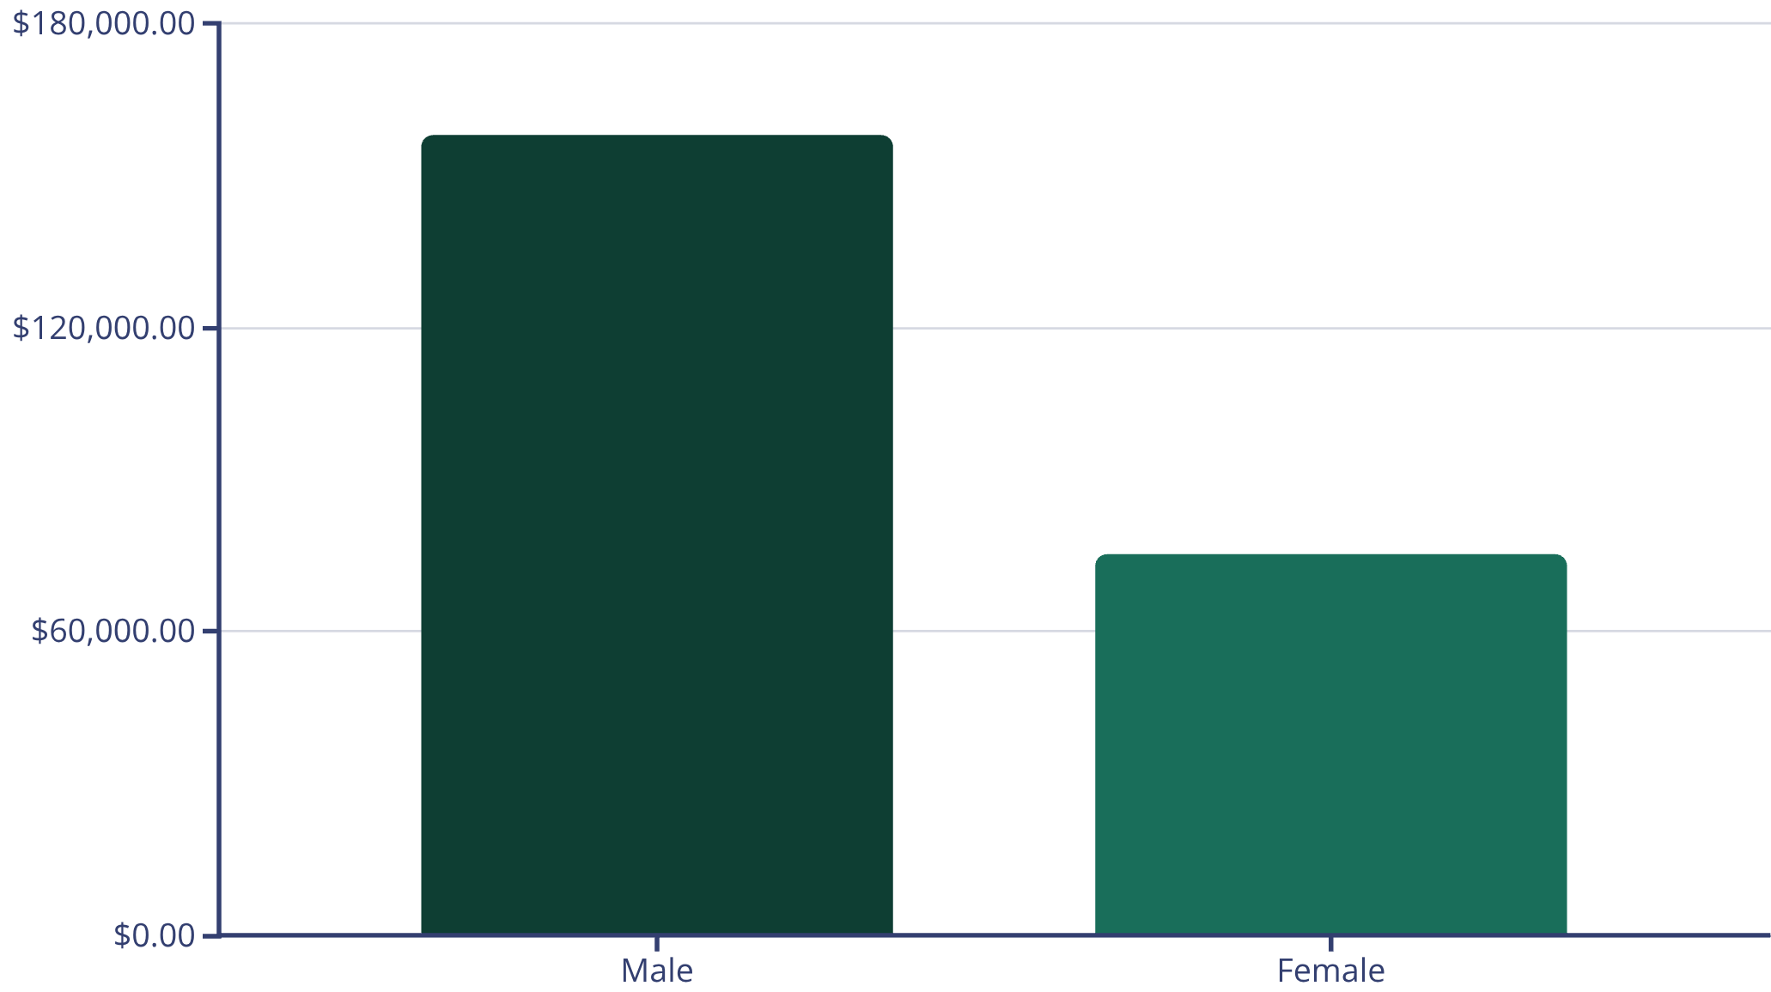
Revenue Insights
$157K
$75K
$60
Male Customer Revenue
Female Customer Revenue
Average Purchase
Significantly higher spending from male customers
Opportunity for targeted marketing growth
Consistent spending across customer base
Male customers drive 68% of total revenue, presenting opportunities to better engage female shoppers through targeted campaigns.

Slide 5

Top-Rated Products
Gloves
Sandals
Boots
Rating: 3.86
Rating: 3.84
Rating: 3.82
Hat
Skirt
Rating: 3.80
Rating: 3.78
These top-rated products should be featured prominently in marketing campaigns and product positioning strategies.

Slide 6



Customer Segmentation
Returning Customers
701 customers (18%)
Loyal Customers
Growth opportunity through loyalty programs
3,116 customers (80%)
Highest value segment with consistent purchases
New Customers
83 customers (2%)
Focus on conversion and retention

Slide 7
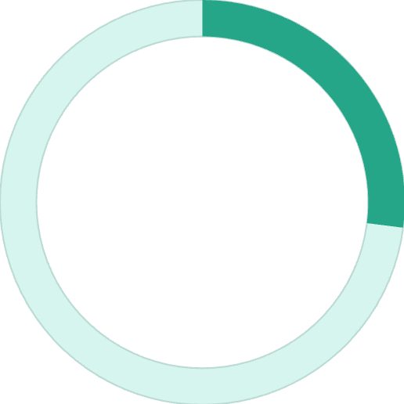
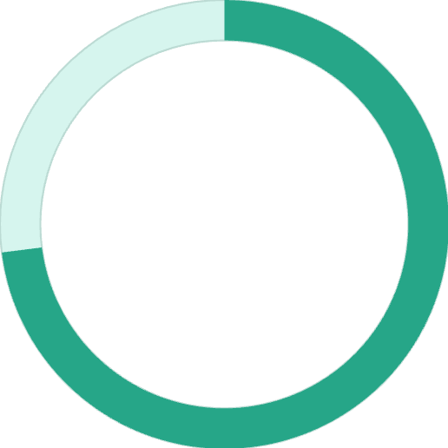

Subscription Analysis
Repeat Buyers & Subscriptions
Among customers with 5+ purchases:
958 are subscribers
27%
2,518 are not subscribers
Massive opportunity to convert loyal non-subscribers
Subscription Rate
1,053 of 3,900 customers
73%
Non-Subscribers
2,847 customers
Key Finding: Subscribers and non-subscribers have similar average spend ($59.49 vs $59.87), but subscribers show higher repeat purchase rates.

Slide 8

Discount Strategy Insights
1
2
3
Discount-Dependent Products
High-Value Discount Users
Shipping Impact
Hat (50%), Sneakers (49.7%), Coat (49.1%) have highest discount rates
Many customers using discounts still spend above average ($60+)
Express shipping: $60.48 avg vs Standard: $58.46 avg
Balance promotional strategies to maintain margins while driving volume.

Slide 9
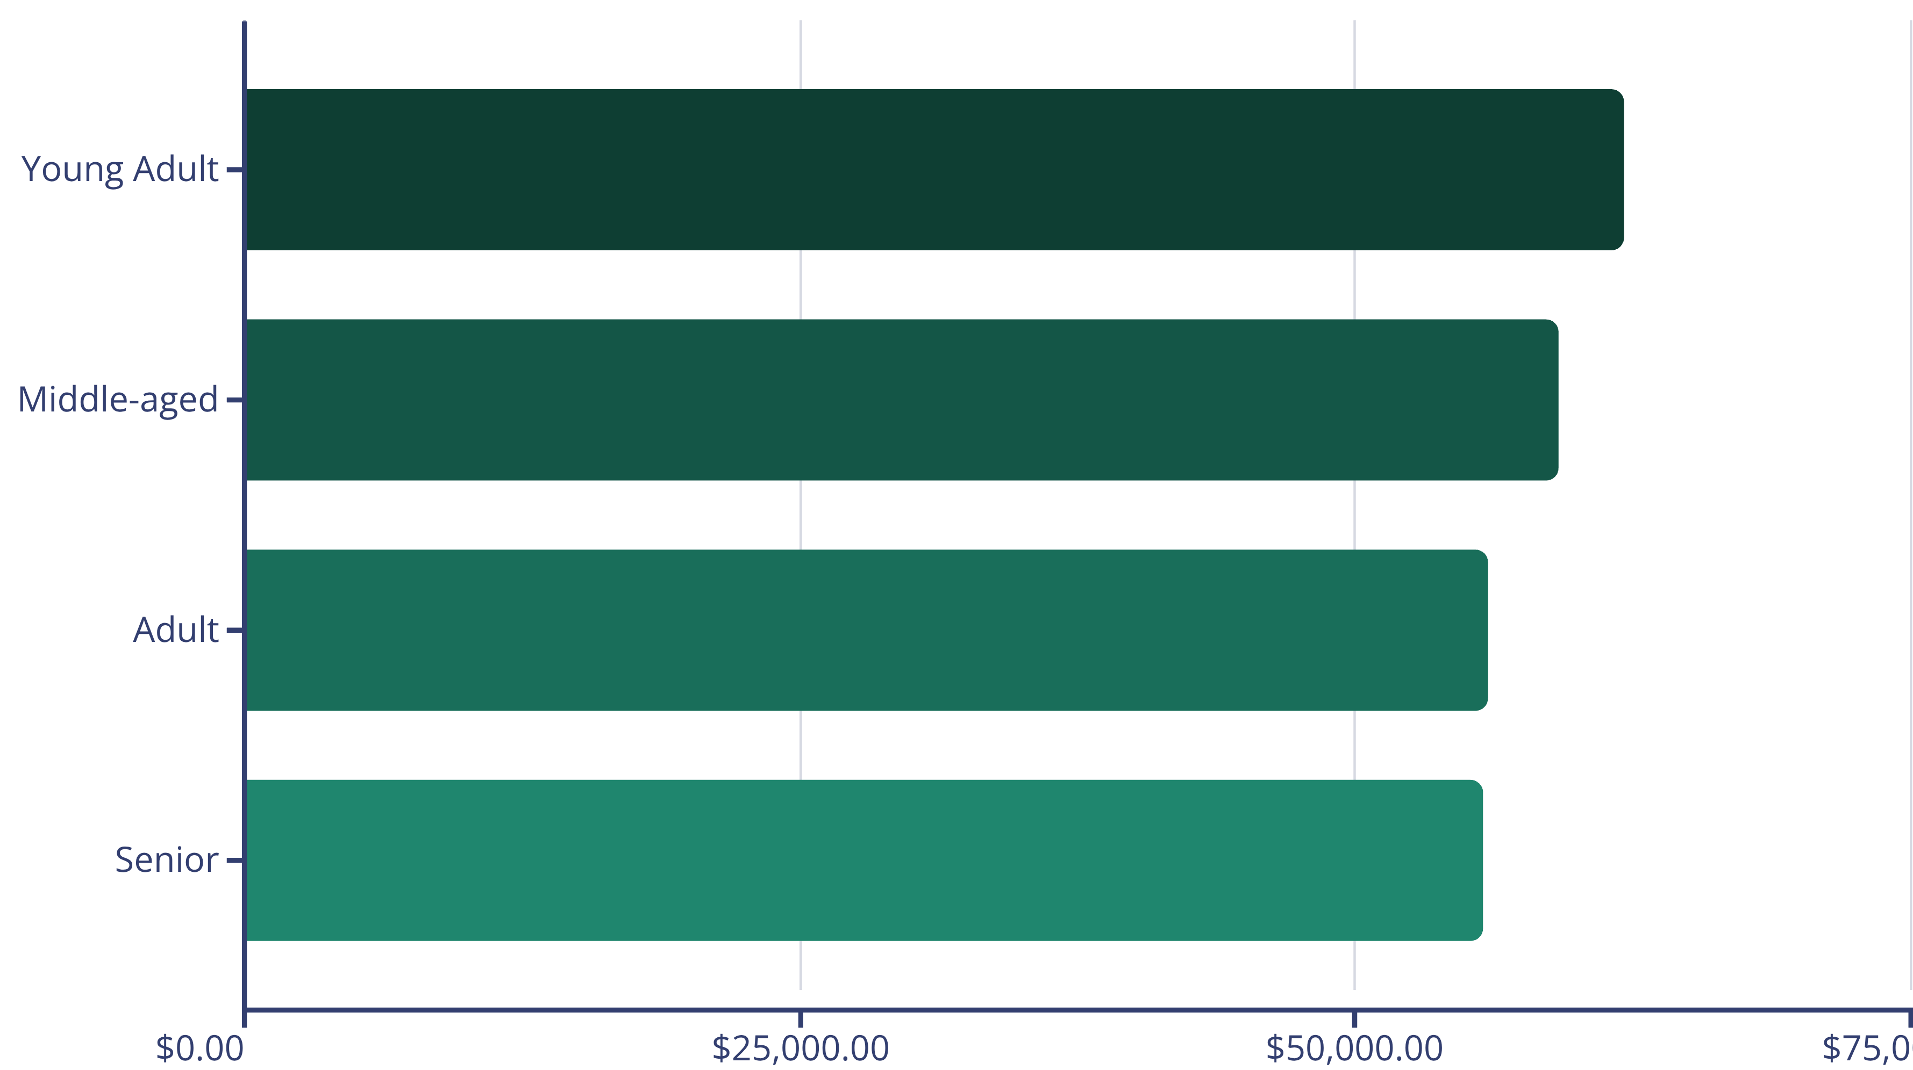
Age Group Revenue Distribution
Young adults lead revenue generation, but all age groups show balanced contribution. Tailor marketing messages to resonate with each demographic.

Slide 10
Strategic Recommendations
Boost Subscriptions
Loyalty Programs
Optimize Discounts
Targeted Marketing
Promote exclusive benefits to convert 2,518 loyal non-subscribers
Reward repeat buyers to accelerate movement into loyal segment
Balance promotional sales with margin control for sustainable growth
Focus on high-revenue segments and top-rated products in campaigns

